Slide 1
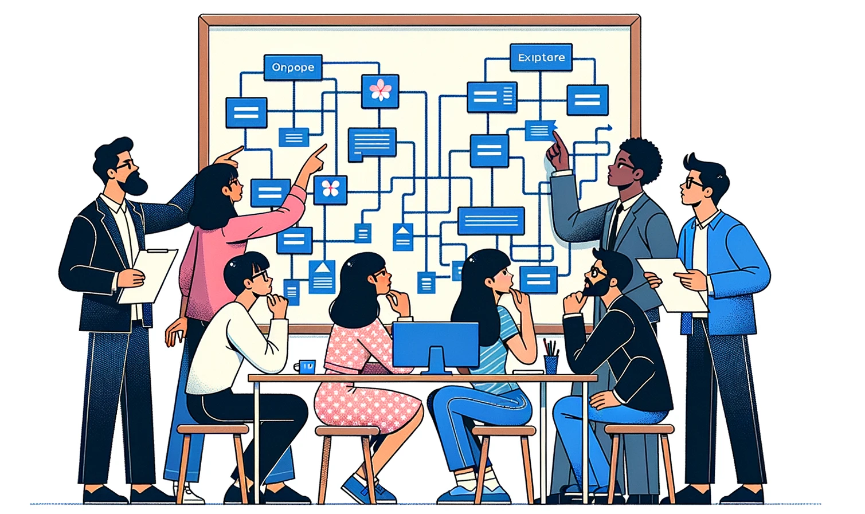
Generative Patterns for AI
Foundations of AI Acceleration
Dan McCreary and Steve Peterson
November 2023

Slide 2
Talk Description
Generative AI is by far the most impactful technology in the last ten years. It dominates the priority list of almost every CIO in the world.
This session will review key architectural patterns that organizations are using to safely harness the power of Generative AI to build intelligent search, chatbots and agents as well as performing a variety of tasks on unstructured text.
We will cover the key use case taxonomies that are emerging and the architectural patterns we need to support these initiatives. If implemented, these patterns can accelerate the process of building intelligent agents for all knowledge workers.

Slide 3


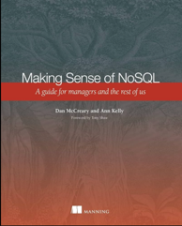


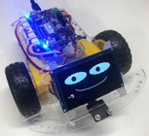


Background for Dan McCreary
Solution architect with over 35 years working with data
Worked for Bell Labs and Steve Jobs at NeXT
Author of a book on database selection “Making Sense of NoSQL”
Promoter of XML and graph query standards (GQL)
Former Distinguished Engineer working for Optum (UHG)
Built the worlds largest healthcare knowledge graph
Lead the “Generative AI Center of Excellence” at Optum
Worked with over 250 healthcare uses cases – 50 which were funded and over 10 in production
Blogger: http://medium.com/@dmccreary
Big fan of AI, robotics, MicroPython, and STEM education
Advocate for neurodiversity

Slide 4

Background for Steve Peterson
Steve Peterson
Senior Director of Enterprise Architecture
Rodan + Fields.
Steve brings over three decades of expertise in spearheading enterprise architecture initiatives. His career has seen pivotal roles at industry giants such as IBM, Be The Match, UnitedHealthcare (UHC) & Optum, and AT&T. At UHC, Steve's visionary leadership in Enterprise Architecture was evident as he crafted strategic roadmaps, particularly emphasizing innovations in integration, chatbots, and Natural Language Processing.

Slide 5
Outline
What
Why
Concepts
Patterns
Examples
Resources
What is an architectural pattern?
Why are they important for discussing architecture tradeoffs?
Building on Enterprise Integration Patterns (EIP)
Key concepts
Large-language model
Embedding
Vector store
Key patterns:
Finetuning
Prompt Enrichment (RAG)
Embeddings
Concept Index (vector store)
Supporting Website: https://dmccreary.github.io/genai-arch-patterns/

Slide 6


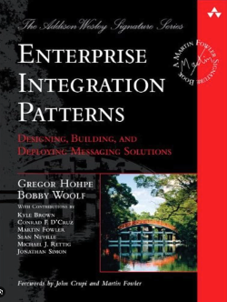
What is an Architectural Pattern?
1979
A general, reusable solution to a commonly occurring problem in software architecture within a particular context
A named way of moving from problem to solution
1994
2003
2014
2023
GenAI
Patterns

Slide 7
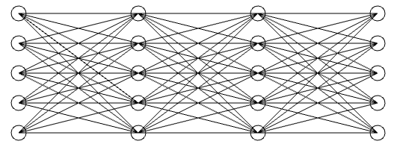
Abstractions and Subsystems
Architectural patterns are high-level abstractions that provides a set of predefined subsystems, their responsibilities, and rules for organizing the relationships between them.
Prompt
Response
Large-Language
Model

Slide 8


Patterns and Bandwidth
Architecture patterns help in laying out the structure for a software system and provide a vocabulary for discussing system design
Precise design patterns create high-bandwidth discussions that help architects quickly understand design tradeoffs
Notes:
Create an image of two business professionals standing in an open space. They are standing far apart. The Asian woman on the left is talking into a cup. The dark skinned man on the right is listening to a cup at his ear. There is a tight string between the two cups. The string is straight. There is nothing in the background.

Slide 9
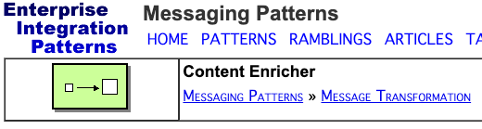
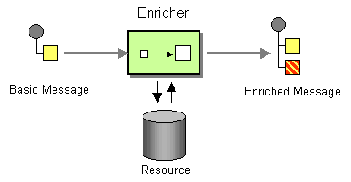
Architecture Patterns Have Diagrams
Good architecture patterns have clear diagrams that have common meaning
New patterns can be derived from similar patterns
Example EIP Pattern: Content Enrichment
https://www.enterpriseintegrationpatterns.com/patterns/messaging/DataEnricher.html

Slide 10
Prompt Enrichment
By using similar terminology that architects are already familiar with, we can quickly build new patterns
Basic Prompt
Enriched Prompt

Slide 11
Architecture Tradeoff Analysis
Business
Drivers
Quality
Attributes
User
Stories
Analysis
Architecture Plan
Architectural
Approaches
Architectural
Decisions
Tradeoffs
Impacts
Sensitivity
Points
Non-Risks
Distilled info
Risk Themes
Risks
This process defined by CMU's Software Engineering Institute

Slide 12
Example: Databases Architectures
Relational
Analytical (OLAP)
Key-Value
key
value
key
value
key
value
key
value
Column-Family
Graph
Document
There is no once-size-fits all. There are only tradeoffs.

Slide 13
Architecture Tradeoffs in Generative AI
Finetune or Prompt Enrichment?
Small model or large model?
Small context window or large?
Response time or high quality?
Vector databases or graph database?
All public documents or role-based access control?

Slide 14
Key GenAI Concepts
Neural networks
Large language models
Prompts
Tokens
Prompt context window
Prompt design and engineering
Embeddings
Concept Index (Vector database)
Comparison and Similarity
Classification

Slide 15
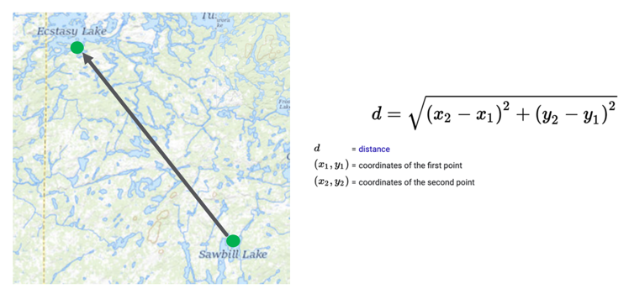
Comparing Items: The Geospatial Metaphor
Any two locations have a “distance” in space between them
We extend this to more than two dimensions
An embedding is expressed as a set of “coordinates” in a 200-dimensional space

Slide 16
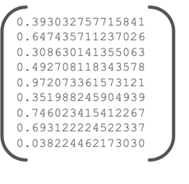
Text Embedding
Text Embedding
Text
How many family practice physicians are there in Minneapolis that are taking new Medicare patients?
128 decimal values

Slide 17
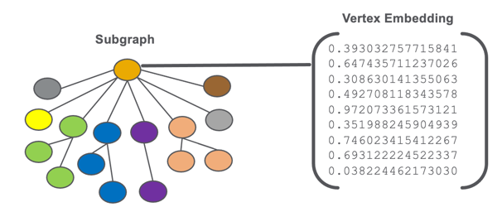
Graph Embedding
256 decimal values
A Representation of a Physician, Member, Customer etc.

Slide 18
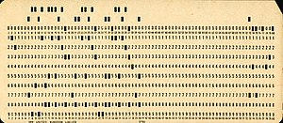
GenAI is about Comparison
Old Way: Counts and Amounts
New Way: Comparison
COBOL Flat Files
Spreadsheets
RDBMS Tables
OLAP Cube
Embedding
Similarity
How do we store knowledge for fast counting?
Tables and OLAP Cubes
How do we store knowledge for comparison?
Graphs and Embeddings

Slide 19
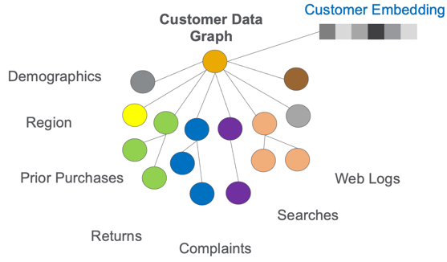
Customer Embeddings
Comparing customers depends on storing their properties and linking customer touchpoints

Slide 20
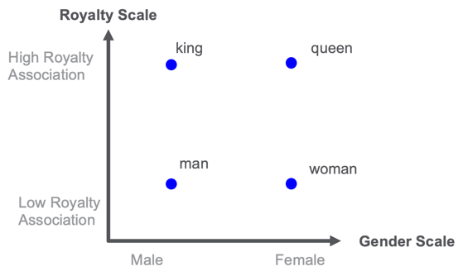
Distance Between Words
Manually rating 40K common English words is too expensive!

Slide 21
Key Question: What Do You Never Want to Compare?
Customers
Products
Competitors
Competitors products
Product comments
Words
Sentences
Paragraphs
Documents
Images
Action items assigned during a meeting
Frequently asked questions
Applications on the desktop
Documents in a knowledge base
Spreadsheets
Reports
Graphics
PowerPoint slides
Virtual machine configurations
Errors in a log file
Answer: None of the above

Slide 22
Example: Benefits Chatbot
Benefit Questions
Medical Advice Questions
Is acupuncture covered by my plan?
Do you think that acupuncture is effective?
You can only answer questions about what is covered in your health plan
You must refuse to answer questions about medical advice

Slide 23
Sample Workflow
Classifier
Happy
Path
Benefit
Question?
Prompt
YES
Next
Step
Error
Response
NO
Architecture is about what boxes we have in our toolchest and how they are connected

Slide 24
Workflows, LangChain and Prompt Enrichment
Do We Have
Enough Info?
YES
Prompt
Next
Step
Embedding
Classifier
NO
Knowledge
Graph
Enrich
LangChain is a software system for building workflows where the components are often large-langauge models

Slide 25
Cooperating Agents
Today
Next Year
Single prompt
Single Large-language model (LLM)
LLMs generate code
Executed code generates prompts
Example: ChatGPT Advanced Data Analytics
Hundreds of agents interacting
Agents calling services and databases
Learning management systems (LMS) suggestion courses, exercises and labs
LLM
LMS
User
LLM
Code
DB
User
3-Agents
System
Code

Slide 26
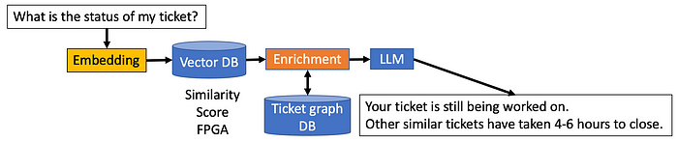
Helpdesk Chatbot

Slide 27
Towards a Loosely Coupled Architecture
Key
LLM Task
New GenAI App
English
Other GenAI Apps
Standard Infrastructure
Single Task
Multiple Tasks
GenAI Wrapper
REST APIs
Agent Safety Guardrails
English
Goal Decomposition
Task Ordering
GenAI Wrapper
Knowledge
Graph
Estimation
Logging
Scheduling
English
Document Cracking
Embedding
Verification
Collection
Notification
Goal: define loosely coupled resilient architecture where clearly defined interfaces allow components to be swapped in and out has technology changes and new contracts are negotiated.
Architecture

Slide 28
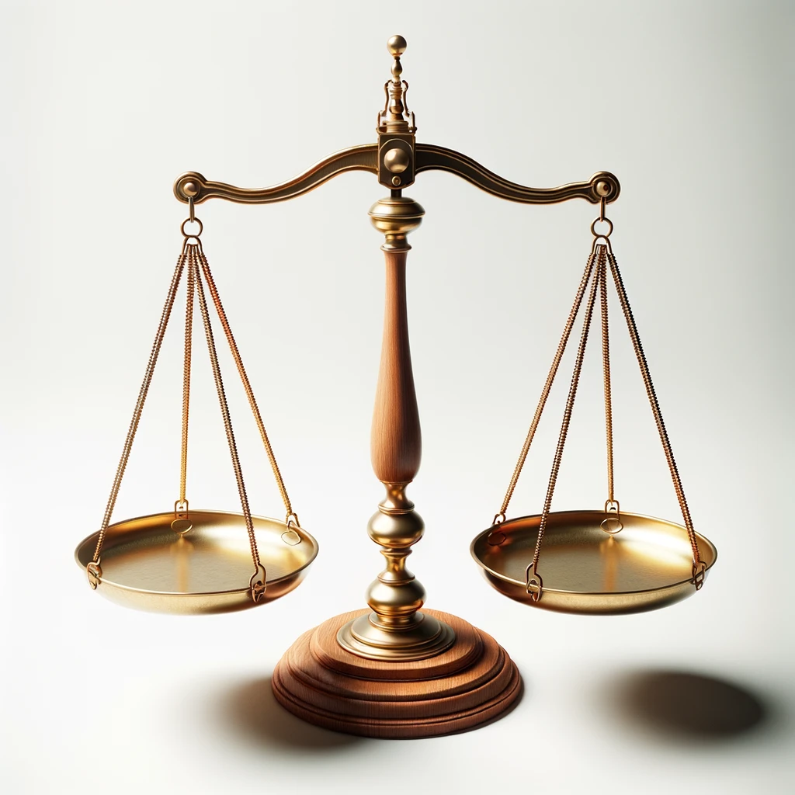
Finding The Simplest Architecture
Complexity has a cost
Can we get by with a simpler architecture?
COST
BENEFITS
The cost of building a model
The of benefits of using the model
Notes:
Prompt: Photo of a traditional balance scale made of polished wood and brass, set against a pristine white background. The scale is evenly balanced, with empty pans on either side.

Slide 29
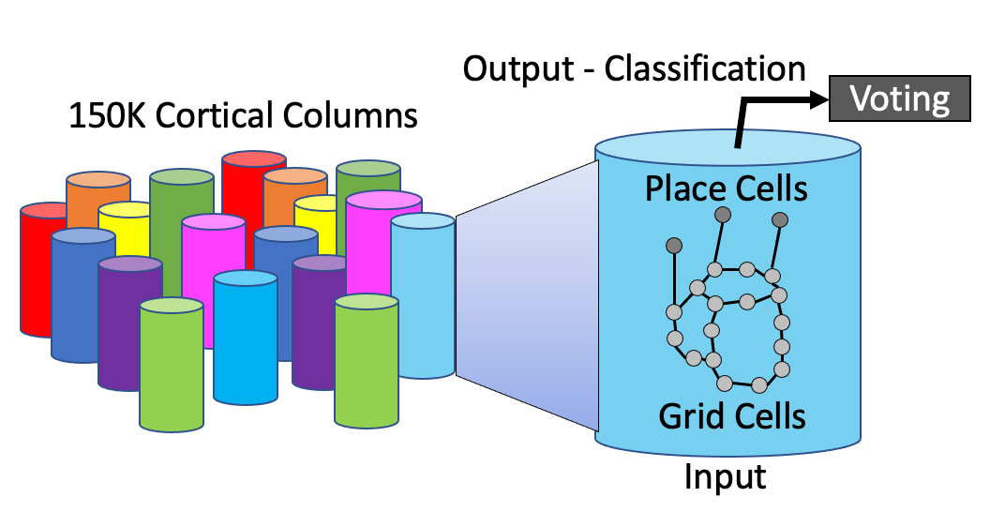
Comparing Knowledge Representations
Large-Language Model (Deep Neural Network)
Works well with current CPU and GPU hardware
Knowledge Graph (Nodes and Edges with Properties)
Our best attempt at creating detailed models of the world with pointers
Reference Frames (used by the human brain)
The way that human intelligence is really represented in the neocortex

Slide 30
Questions
Thank You!
Dan’s LinkedIn: https://www.linkedin.com/in/danmccreary
Steve’s LinkedIn: https://www.linkedin.com/in/steven-peterson-7928995/
Blog: http://medium.com/@dmccreary

